Slide 1
Intro to Genomics

Slide 2
Epistemic Status
I’m also a beginner on this topic
Didn’t learn it in grad school, but recently assigned a GWAS project at my job so I’ve been teaching it to myself

Slide 3
Review of Mendelian Genetics

Slide 4


Slide 5
X
100%

Slide 6
X
X
100%
75%
25%

Slide 7
Mendelian Genetics
Gene - discrete unit of heredity (example: gene for flower color)
Alleles - Different versions of a gene
B: allele for blue flowers
b: allele for white flowers
Each plant has two copies.
If one of each, then dominant one determines color
BB -> blue flowers
bb -> white flowers
Bb -> blue flowers
Genotype: what alleles a plant has
Phenotype: the plant’s color

Slide 8
Mendelian Genetics
If we know the genotypes of two plants, we can predict the color distribution of the offspring from crossing them.
B
B
B
b
b
Bb (blue)
25%
Bb (blue)
25%
B
BB (blue)
25%
Bb (blue)
25%
b
Bb (blue)
25%
Bb (blue)
25%
b
Bb (blue)
25%
bb (white)
25%

Slide 9
Revisiting our previous results…

Slide 10
BB
bb
X
100%
Bb

Slide 11
BB
bb
Bb
Bb
X
X
100%
75%
25%
bb
Bb
25% BB
50% Bb

Slide 12
Review From Yesterday

Slide 20
mRNA transcripts can be measured experimentally

Slide 21
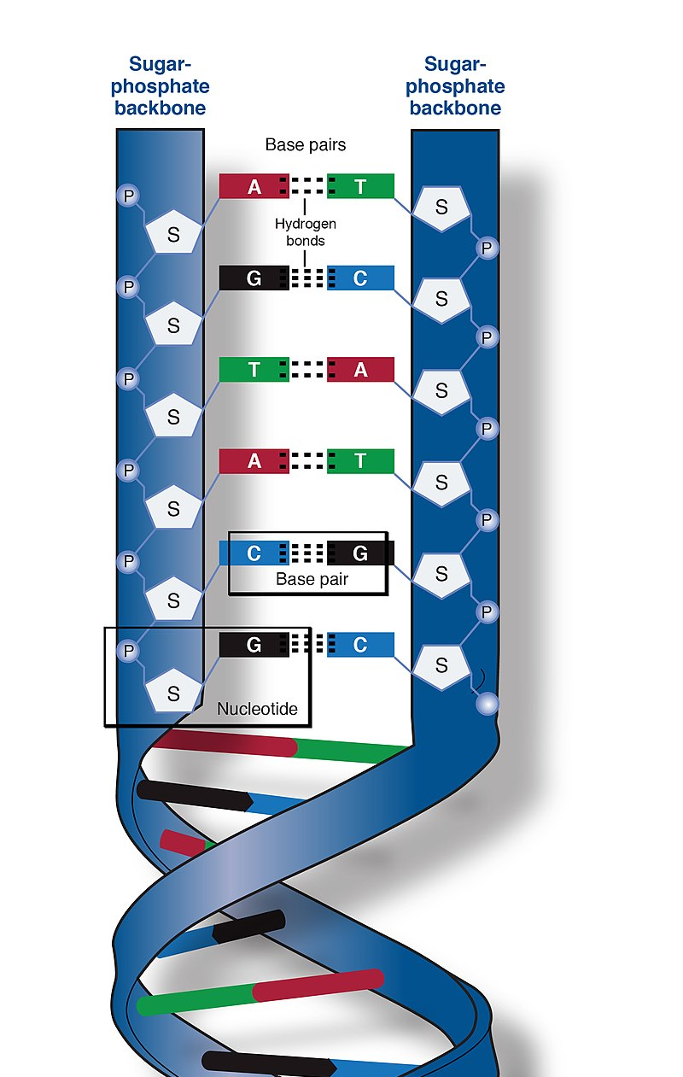
DNA
Four bases:
Adenine
Thymine
Cytosine
Guanine
A and T are complementary
C and G are complementary
Two complementary bases are called a “base pair”
Sequences of base pairs encode information
Image source: https://en.wikipedia.org/wiki/DNA#/media/File:Phosphate_backbone.jpg

Slide 22
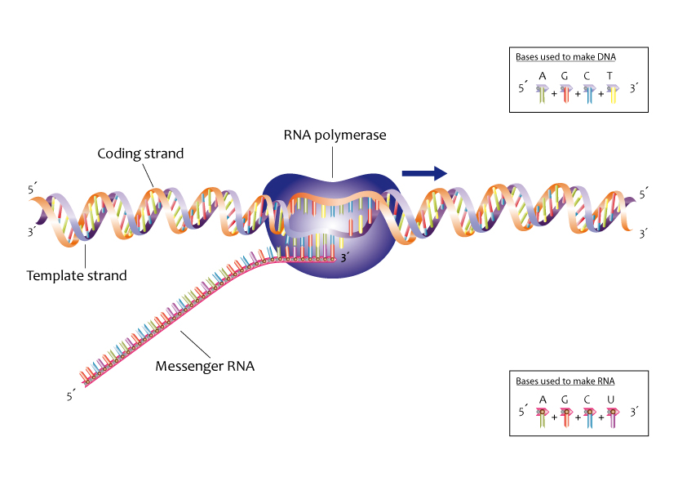
Transcription
Image source: https://commons.wikimedia.org/wiki/File:Process_of_transcription_%2813080846733%29.jpg

Slide 23
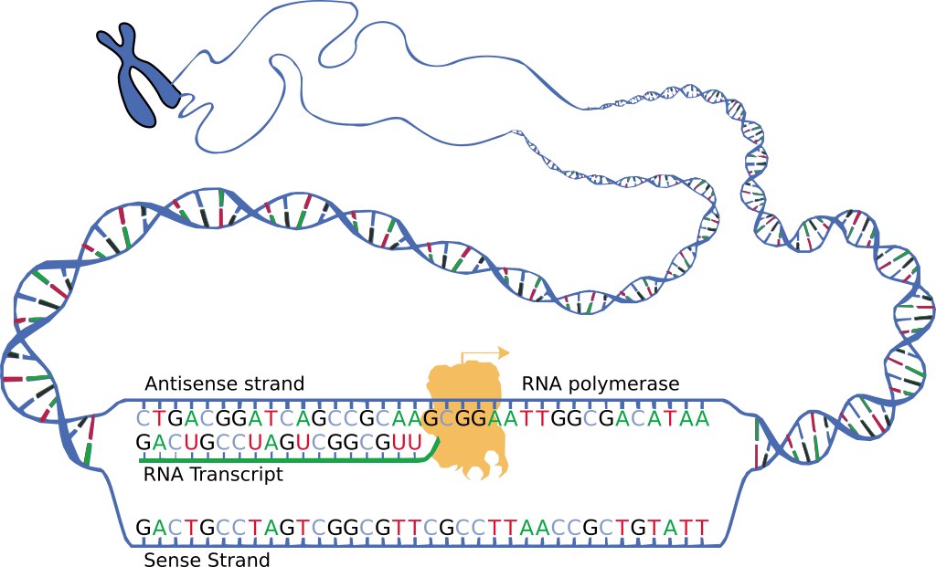
mRNA
Image source: https://en.wikipedia.org/wiki/Messenger_RNA#/media/File:DNA_transcription.svg
Nucleic acid, like DNA
Four bases:
Adenine
Uracil
Cytosine
Guanine
Single stranded (usually)
One of several types of RNA

Slide 24
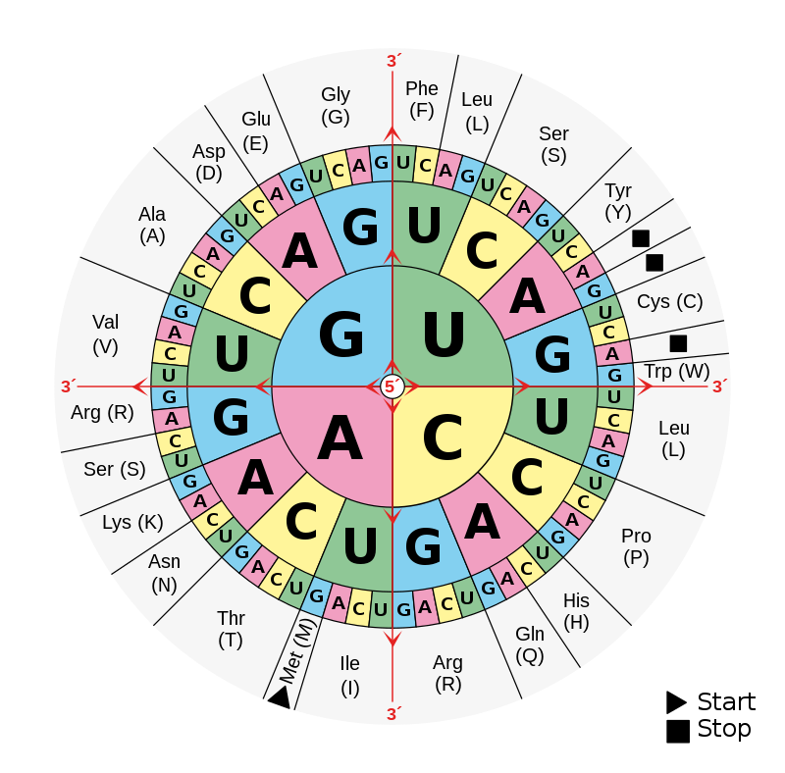
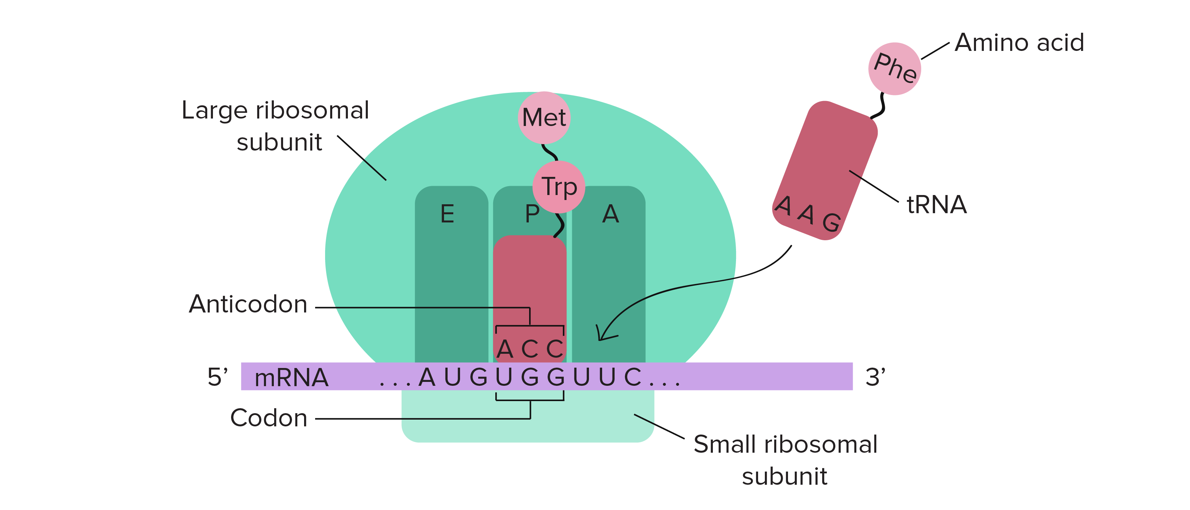
Translation
Image source: https://en.wikipedia.org/wiki/DNA_and_RNA_codon_tables#/media/File:Aminoacids_table.svg
Image source: https://www.khanacademy.org/science/biology/gene-expression-central-dogma/translation-polypeptides/a/the-stages-of-translation

Slide 25
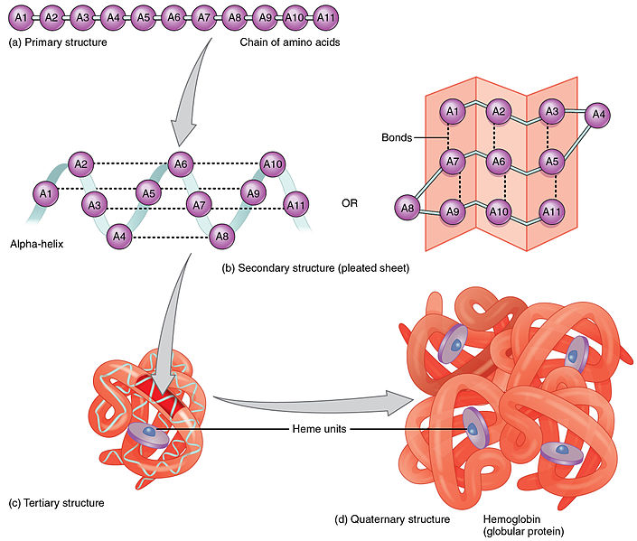
Protein
Image source: https://commons.wikimedia.org/wiki/File:225_Peptide_Bond-01.jpg
Chain of amino acids produced during translation is folded to produce final protein.
Proteins do the work of the cell: catalyzing metabolic reactions, structural support, signaling, regulating cellular processes, etc.

Slide 27
Modern Genetics

Slide 28
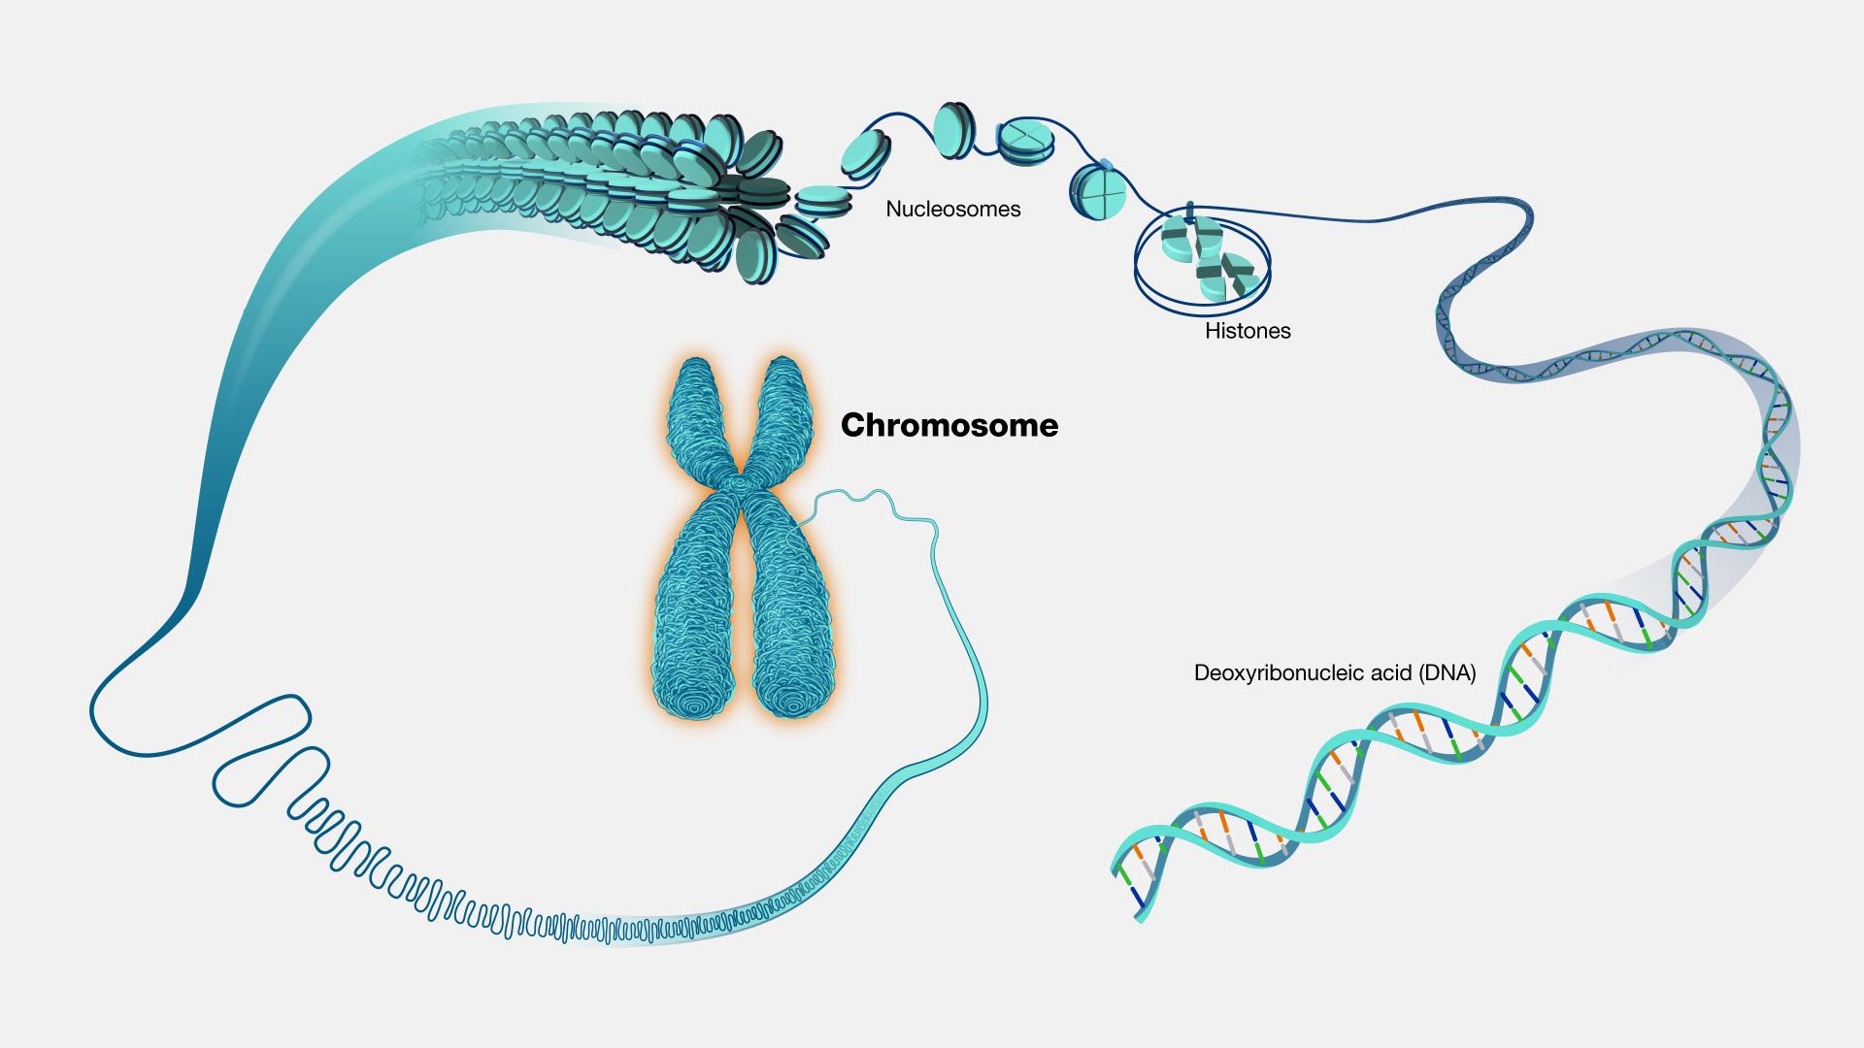
Chromosomes
Image source: https://www.genome.gov/genetics-glossary/Chromosome

Slide 29
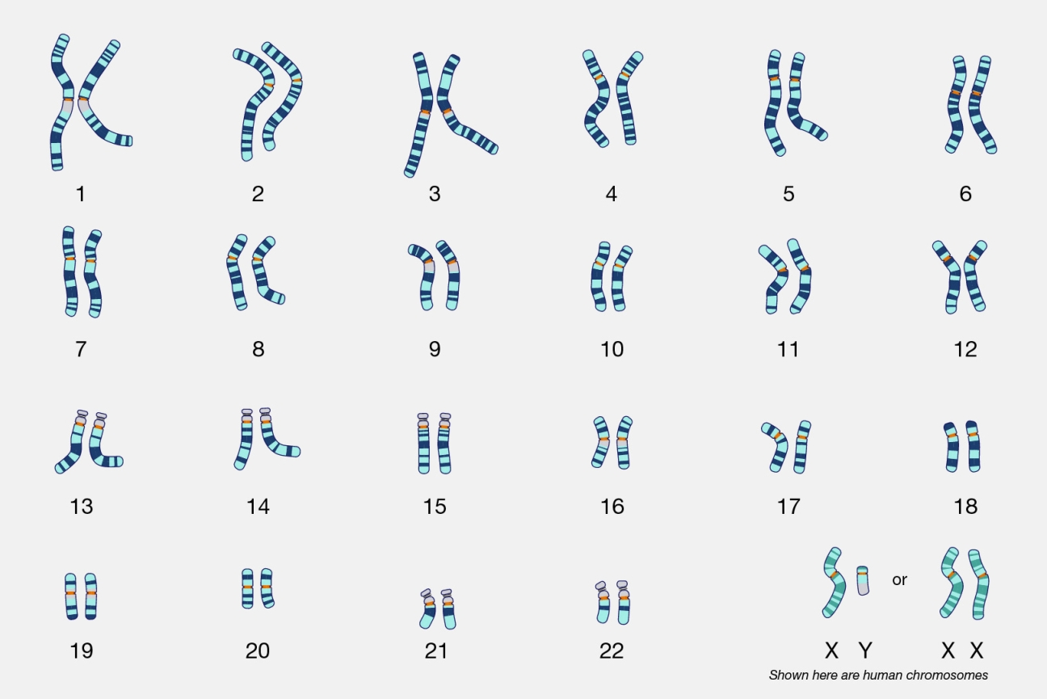
Chromosomes
23 pairs, so 46 total
One copy from mother, one from father
Numbered 1-22, plus sex chromosomes X and Y
Diploid (2n): 46 (two each)
Most of the body’s cells
Haploid (n): 23 (one each)
Gametes (reproductive cells)
Image source:
https://www.genome.gov/genetics-glossary/Karyotype

Slide 30
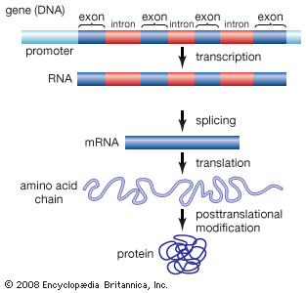
Parts of DNA sequence
Exon - Coding regions are used to specify the string of amino acids going into the protein
Picture isn’t really to scale. Reality is only a small fraction of DNA sequence is exons.
Introns - Non-coding regions that transcribed into mRNA but then spliced out.
Promoter - region where RNA-polymerase and transcription factors bind to gene to initiate transcription.
Image source: https://kids.britannica.com/kids/assembly/view/114928

Slide 31
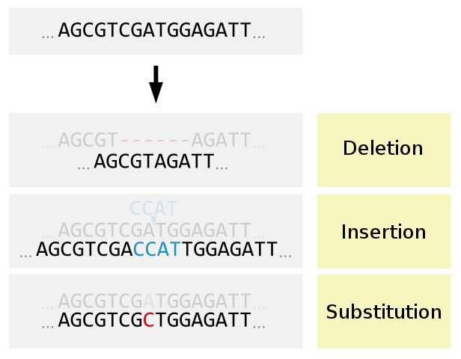
Types of Mutations
Image source: https://commons.wikimedia.org/wiki/File:Deletion_Insertion_Substitution-en.svg/

Slide 32
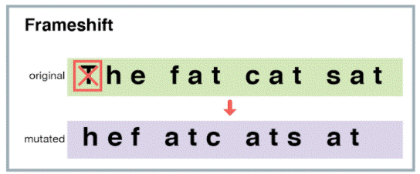
Frameshift from Insertion/Deletion
Image source: https://evolution.berkeley.edu/dna-and-mutations/types-of-mutations/

Slide 33
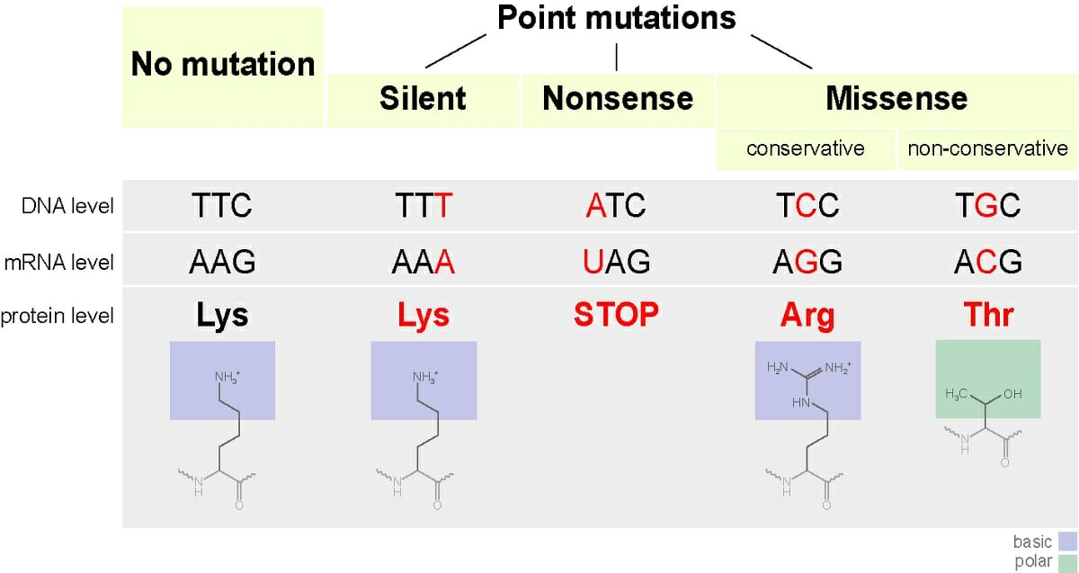
Image source: https://biologydictionary.net/missense-mutation/
Image source: https://en.wikipedia.org/wiki/DNA_and_RNA_codon_tables#/media/File:Aminoacids_table.svg

Slide 34
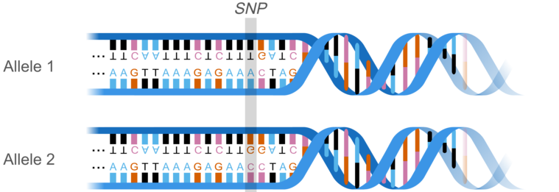
Single-Nucleotide Polymorphisms (SNPs)
Image source: https://commons.wikimedia.org/wiki/File:AllelemodWlocus%26karyotype_eng.png

Slide 35
SNP vs substitution point-mutation
Similar in terms of effect (or non-effect)
Calling a variation a SNP implies that it’s somewhat common, typically found in at least 1% of population.

Slide 36
Modern Genetics
Gene - segment of DNA that contains instructions to produce a product
Alleles - Different versions of a gene
Single-nucleotide polymorphism (SNP) - one base-pair difference between alleles
Where Mendel was right:
Two copies of each gene, one from each parent
Might be two copies of the same allele, or two different alleles
Where it’s more complicated:
Many traits are more complicated than the simple flower example, involving many genes, influence of non-genetic factors, and continuous phenotypes (ex: height)

Slide 37
Project 2: GWAS

Slide 38

Zombology Basics
Mysterious virus affects people differently
Upon contact with virus, some die (called “normal phenotype”) and some become zombies.
Goal: Analyze genomic data to look for SNPs related to virus response.
Zombie phenotype

Slide 39
Zombie SNP Dataset
48,752 SNPs (actually this is a pretty small dataset)
100 normal samples, 100 zombie samples
https://github.com/mikesaint-antoine/comp_bio_seminar/tree/main/project2/data
snp_id | ref | var | normal_1 | normal_2 | normal_3 | zombie_1 | zombie_2 | zombie_3
chr1:944564 | T | C | 0 | 1 | 1 | 0 | 0 | 0
chr1:950243 | A | C | 2 | 2 | 1 | 1 | 2 | 1
chr1:959842 | C | T | 1 | 2 | 1 | 2 | 1 | 1
chr1:990417 | T | C | 0 | 2 | 2 | 2 | 2 | 2

Slide 40
Further Learning and Career Advice

Slide 41
Educational Resources
https://learnbioinformatics.org/

Slide 42
